Slide 1
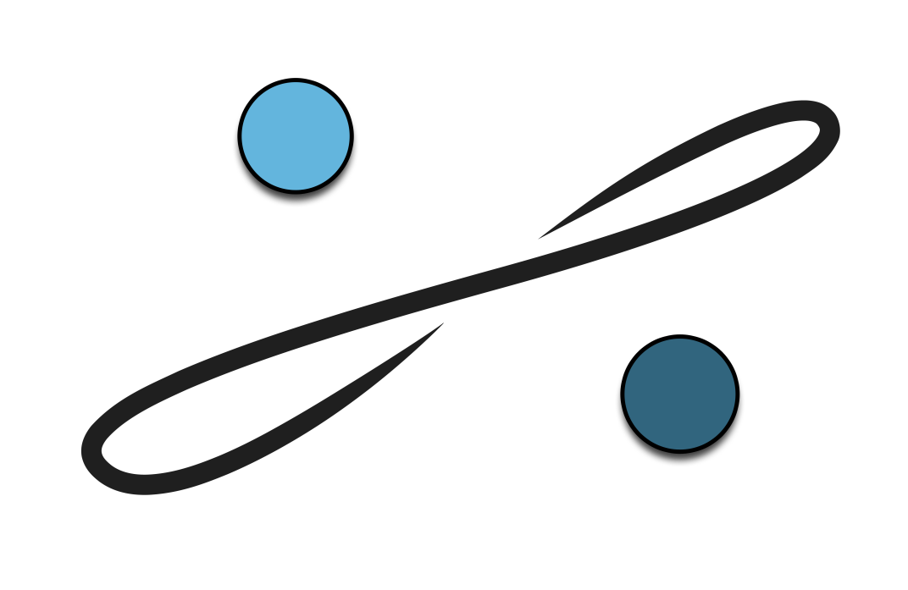


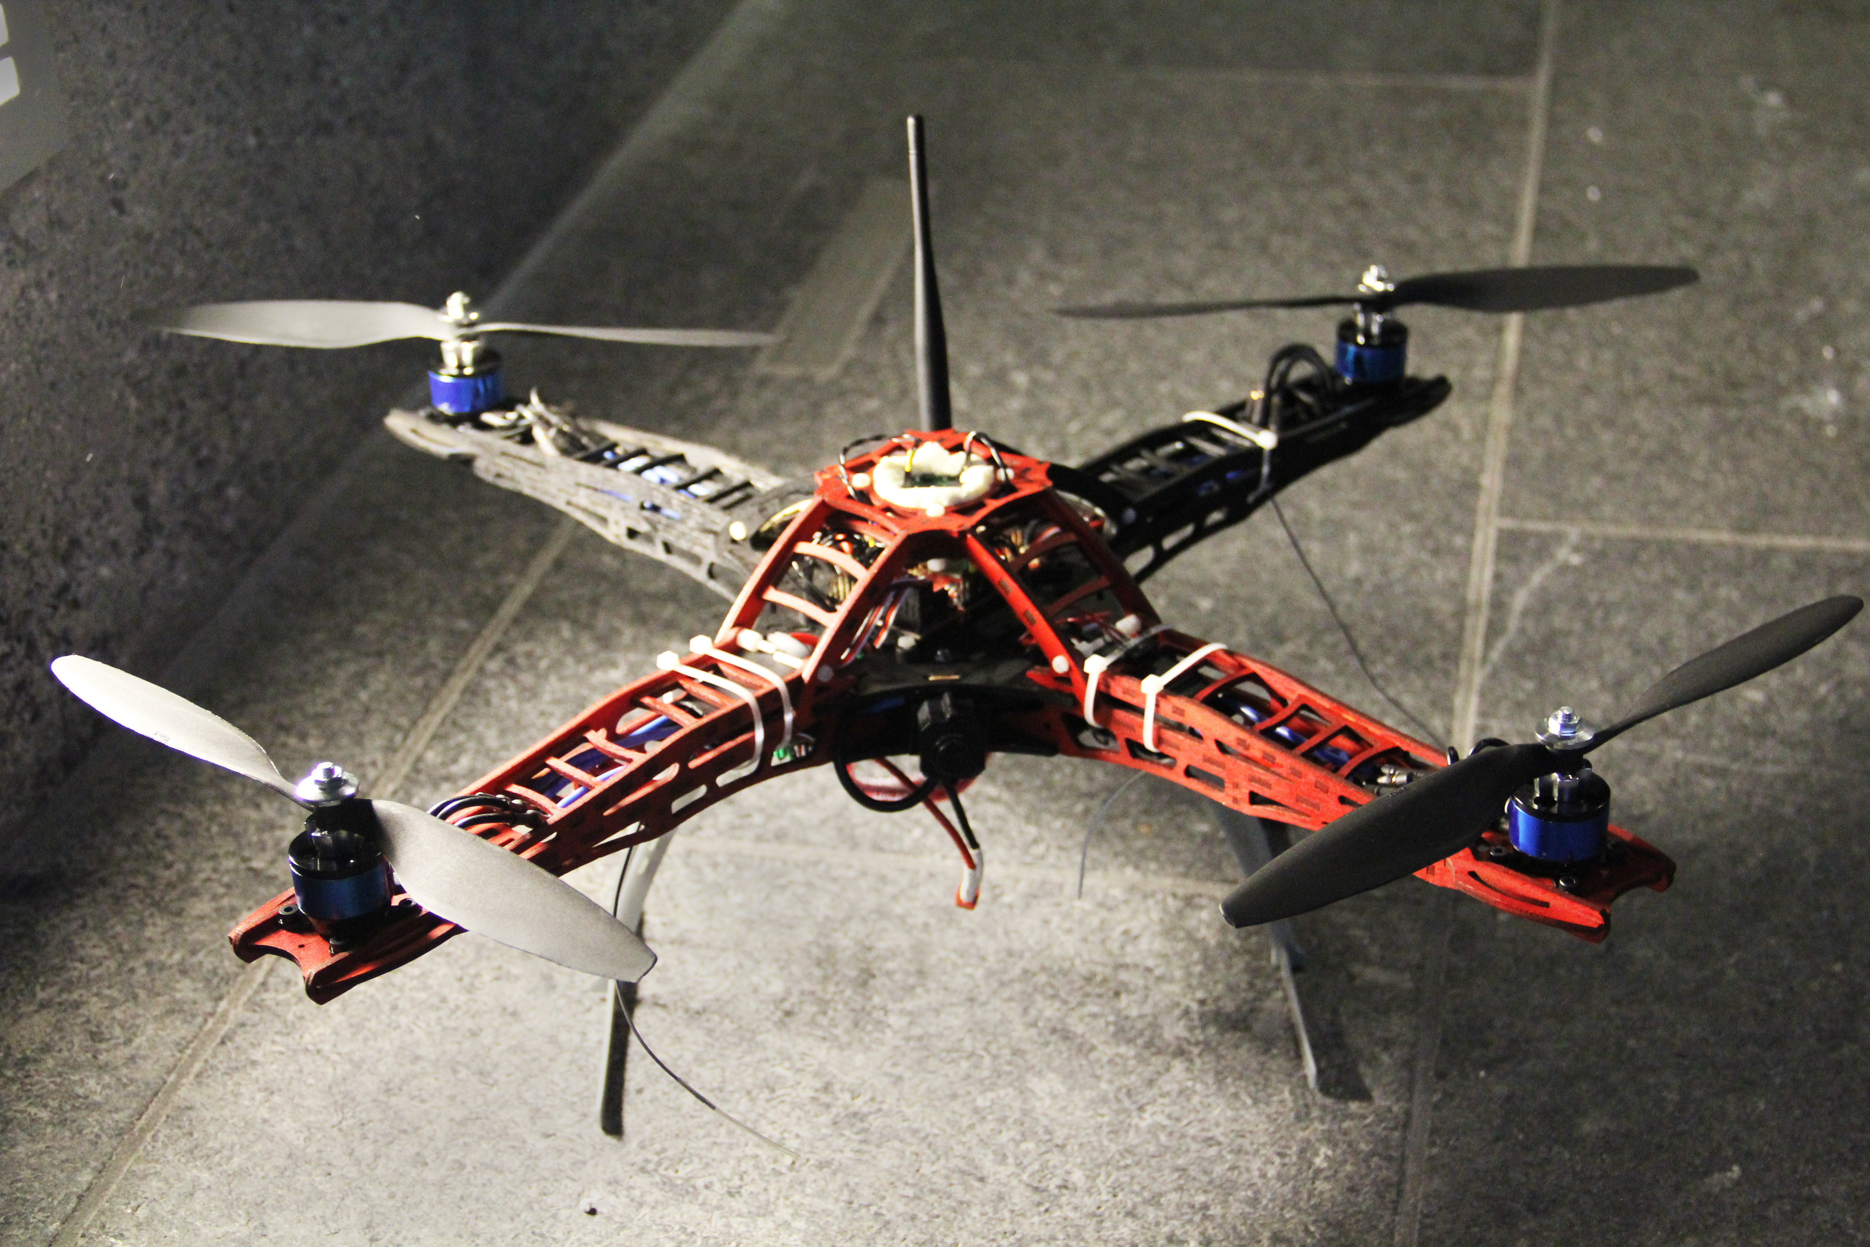
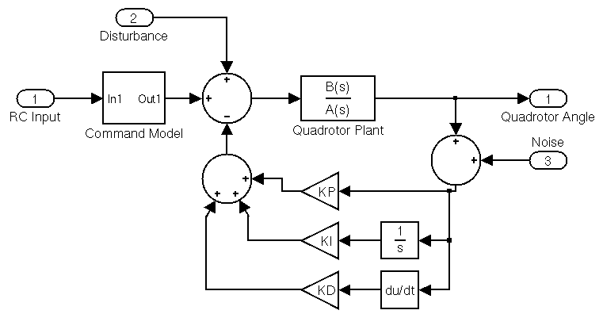
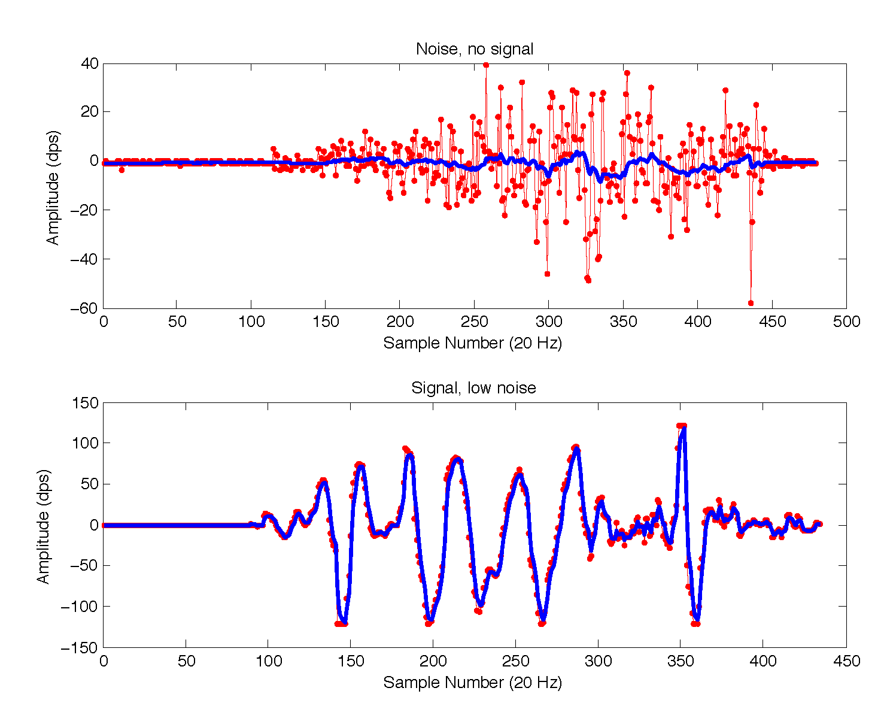
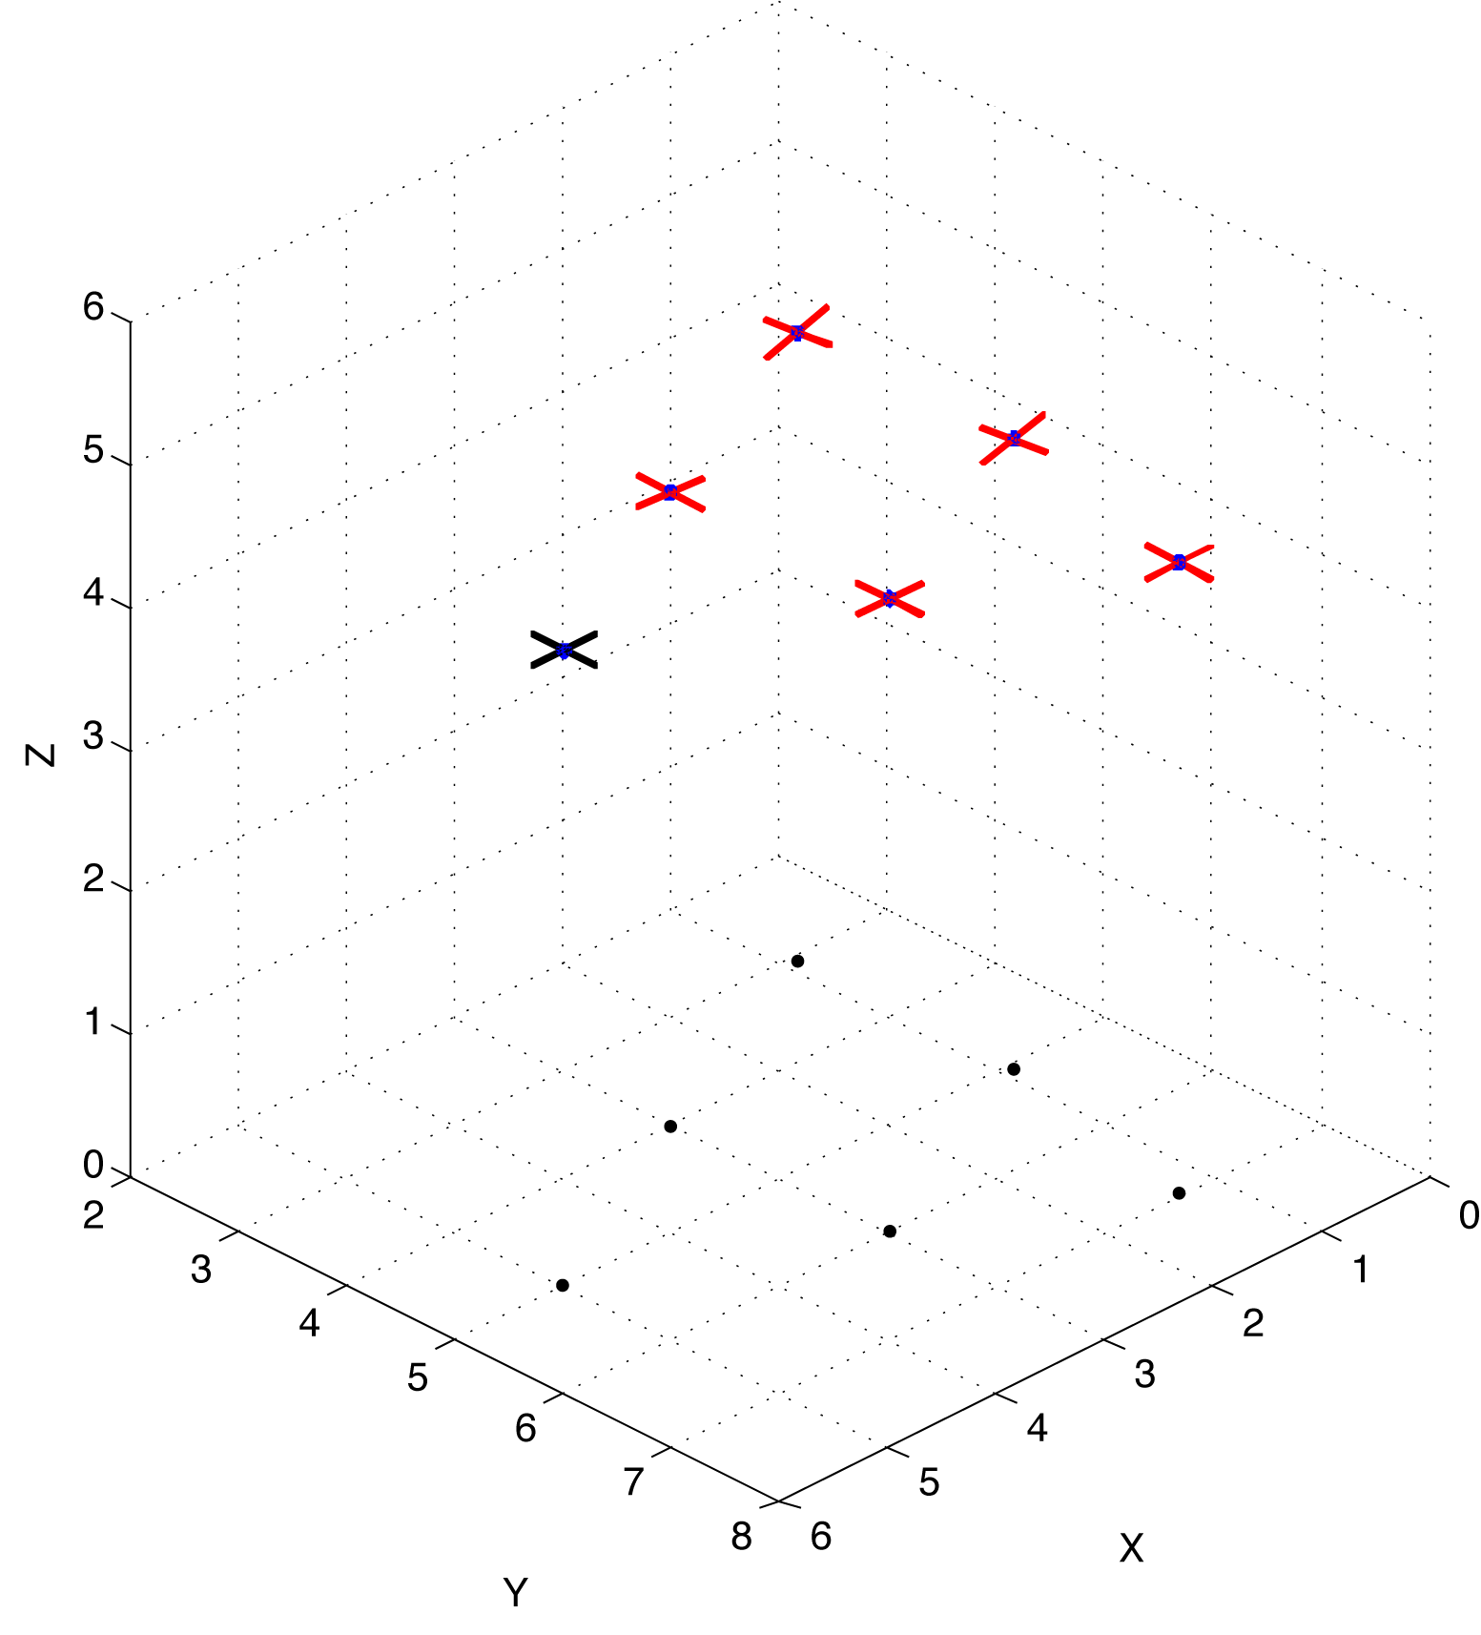
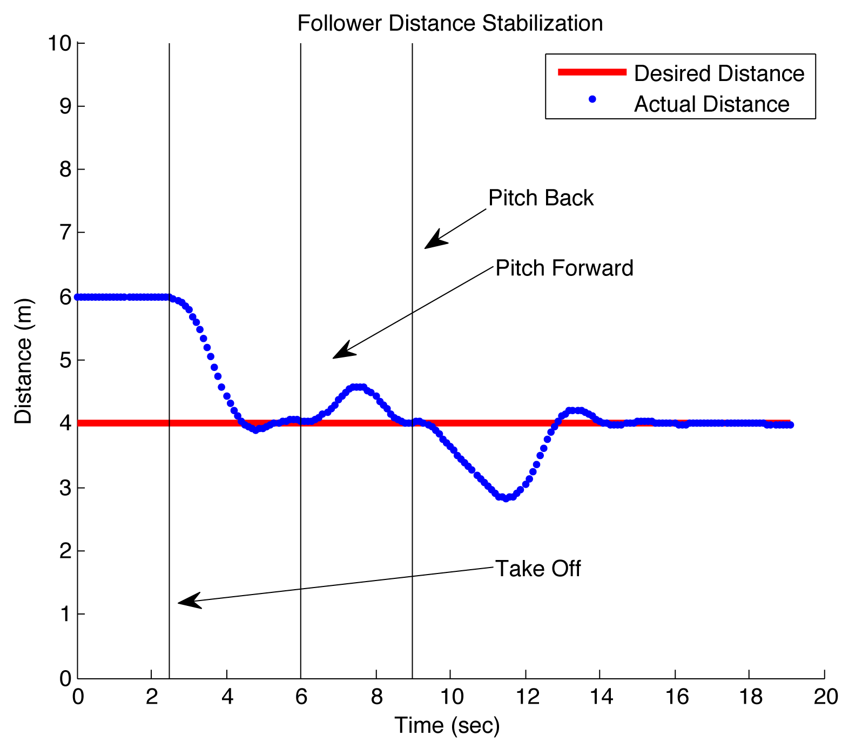
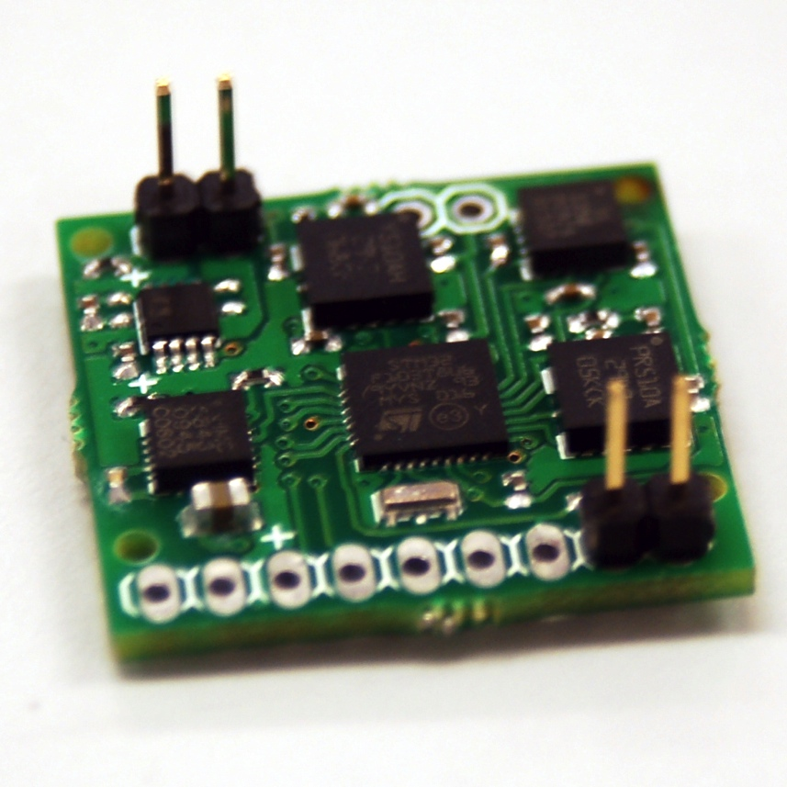
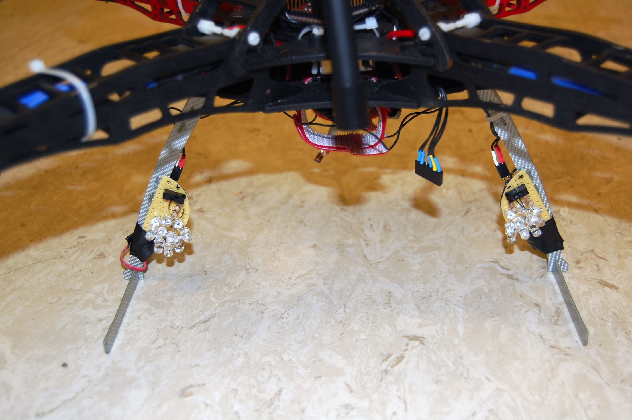
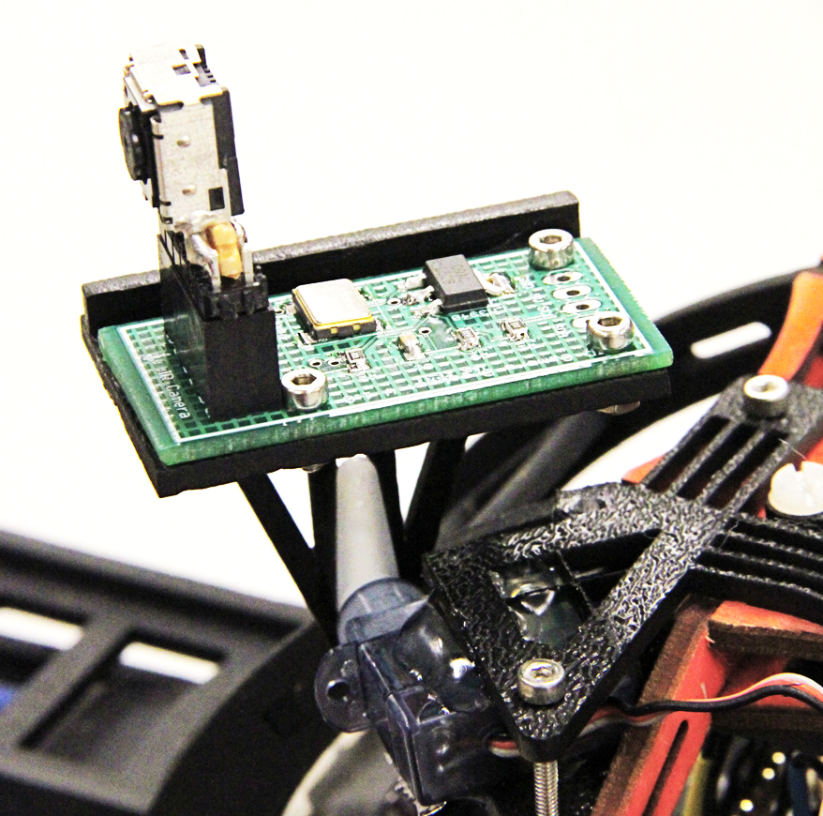
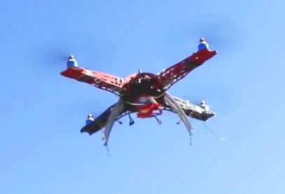
Recursive Flock
R.A.V.E.N.
Remote Autonomous Vehicle Explorer Network
William Etter, Paul Martin, and Rahul Mangharam
http://www.airhacks.org | http://mlab.seas.upenn.edu/
RAVEN is a leader-follower network of quadrotors capable of human-controlled and autonomous flight navigation for search & rescue operations.
RAVEN uses a combination of on-board vision tracking and wireless communication of attitude measurements to track a leader autonomously.
Stability Control
Design
Flocking Model
A PID control loop is used to stabilize the attitude of the quadrotor using Euler angles Φ, Θ, ψ—three control loops in total.
A numerical integration model is used to verify the algorithms and transforms needed to convert IR Camera and wireless attitude information to desired angles.
A Matlab model is used to verify the algorithms and transforms needed to compute desired angles. The model is characterized by:
Quadrotor units as dynamic objects
Numerical integration from angular accelerations to angles
Simulated on-board camera and RF link
Recursively defined flocking configurations
PID Control for a Single Angle
Low-Pass Filter on Rate Gyro Noise for Derivative Feedback
Experimental PID gain values:
K_{P}(Φ, Θ) = 7.5
K_{I}(Φ, Θ) = 0.0
K_{D}(Φ, Θ) = 2.15
K_{P}(ψ) =9.0
K_{I}(ψ) = 0.0
K_{D}(ψ) = 2.6
Hardware and software used:
6 Degree of Freedom IMU at 255 Hz
Consumer ESC brushless DC motor controllers (upgraded to 400 Hz)
Extended Kalman Filter
ATMega1280 16 MHz microcontroller for main control loop
First order digital low-pass filter for rate gyro noise reduction in mid-flight
Model shows under ideal conditions, system will be:
Robust to noise in both RF and camera
Operational with field of views (FOV) >50 degrees
6 DoF IMU
Top Left: Recursive Flock Top Right: PID on relative position
Bottom Left: Simulated camera FOV Bottom Right: Response to pseudo-random errors
Sensor Fusion
Network Sensing & Control
Wireless Link:
IEEE 802.15.4 Zigbee 900 MHz link
Leader to Follower: 20 packets / 60 Bps
Leader to Base: 5 packets / 15 Bps
Follower to Base: 20 packets / 480 Bps
Infrared Camera:
500 Hz I²C Camera, 4 point tracking, 1024x768 resolution
2 5x2 arrays of 950 nm infrared LED beacons on leader
Servo-controlled pitch to increase effective FOV
Flight Test Results
Attitude During Flight
The AutoPilot microcontroller on the follower unit reads data from the Zigbee wireless transceiver, the IR Camera vision system, and the Inertial Measurement Unit, resulting in a data collection containing the attitude information for both the lead and following units as well as perceived beacon placement.
Leader-Follower Pair
Long-term attitude stabilization of follower quadrotor during flight
Red = Yaw
Blue = Pitch
Green = Roll
Leader Attitude (RF)
Using all of this information, the AutoPilot performs several transformations and calculations to determine the follower’s position in relation to the lead unit in terms of horizontal (X), lateral (Y), and vertical (Z) displacements.
IR Camera Point Tracking
Follower IR Camera
AutoPilot Microcontroller
Positional PID Loop
Displacements and commanded controls?
IR Camera Errors vs. Displacement: measured and computed distances vs. actual measured distances. The top represents a location closer to the lead quadrotor.
Autopilot control response to disturbances in distance to leader.
Follower set to hold 130 cm distance behind leader
20 second test and then auto-land
Attitude During Flight
Follower Attitude (IMU)
Once calculated the displacements are used in a control loop that attempts to maintain a fixed position in relation to the leader. Outputting pulse-width-modulated (PWM) signals to the flight microcontroller, the AutoPilot mimics a user’s commands for throttle and desired yaw, pitch, and roll angles.
Leader 950 nm IR Beacons
Infrared Camera and Servo Mount
System Overview

